Slide 1
Unmanned Aerial Vehicle Hardware System
Name: Luqman Hakim Bin Mohamad Salmi
Matric Number: 1718219
Section: 1

Slide 2
Main Components
Physical design for various applications
Locomotion system and actuators
Navigation system and control
Data collection
Data transmission
Power management

Slide 3
Physical Design
There are three different types of UAV design which consist of:
Fixed-wing UAV
Single-rotor UAV
Multi-rotor UAV

Slide 4
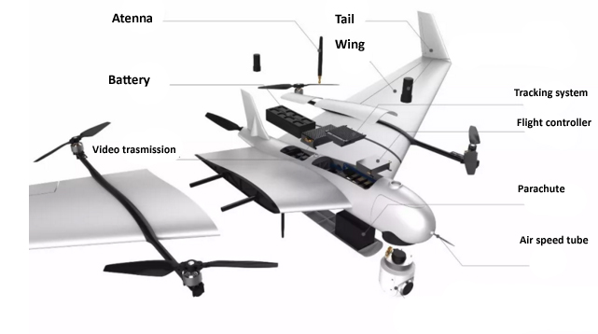
Physical Design (Fixed-wing UAV)
The appearance of the UAV is like an airplane
Needs a runway to be launched to the air
Best used for long distance operations

Slide 5
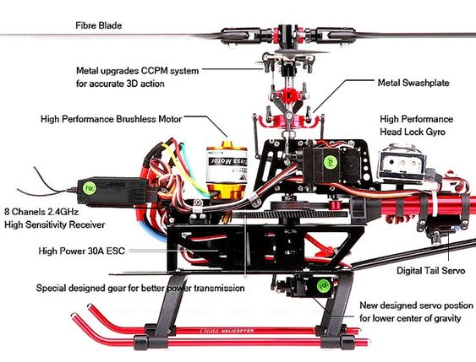
Physical Design (Single-rotor UAV)
The appearance of the UAV is like a helicopter
Only have one rotor to move the blades plus a tail rotor to control its heading
Has higher efficiency over multi-rotor UAV
However, poses higher risk when navigating it close to people

Slide 6
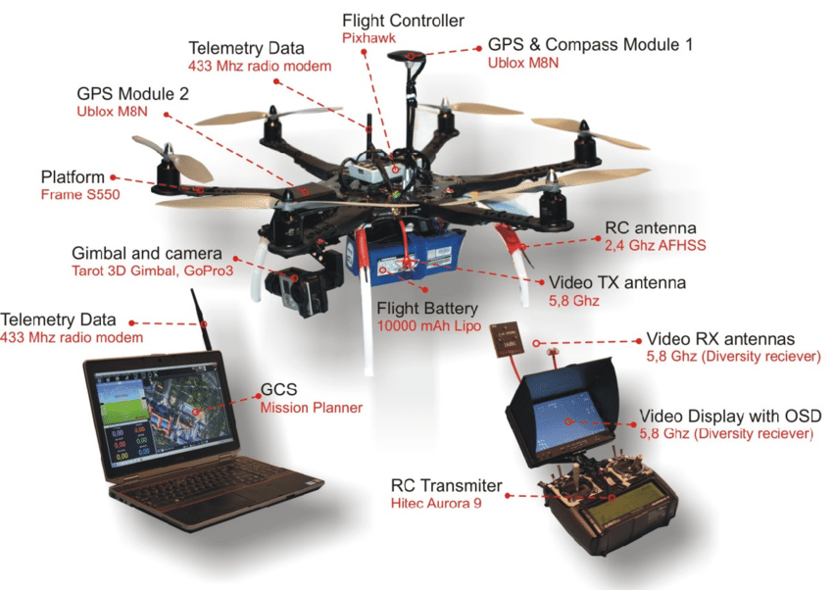
Physical Design (Multi-rotor UAV)
The most common type of UAV due to it being the cheapest and easiest to control
Commonly used for aerial photography
However, the downside of having multi-rotor is that a huge portion of energy is used to fly them and stabilize them in the air

Slide 7
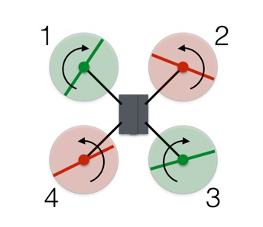
Locomotion System and Actuators
A multi-rotor UAV achieves flight in the air by using their propellers
The green propellers move in clockwise rotation while the red propellers are counter-clockwise
In order to lift, hover and descend, the speed of the motor is changed to provide force with respect to the gravitational force
The UAV also does not spin in the air because of the zero angular momentum achieved by the clockwise and counter-clockwise rotation of the propellers

Slide 8
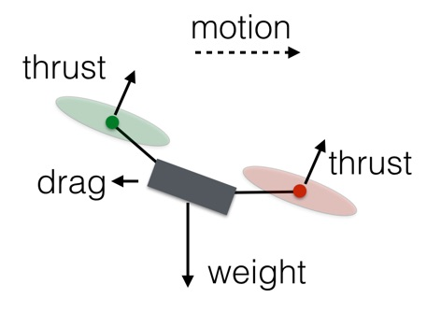
Locomotion System and Actuators
For the multi-rotor UAV to propel to any direction, the UAV needs to tilt its body such as in the diagram
The speed of the motors on the front side are reduced while the speed of the motors on the rear side are increased
This way, the vertical motion of the UAV is constant while only the horizontal motion of the UAV exists

Slide 9
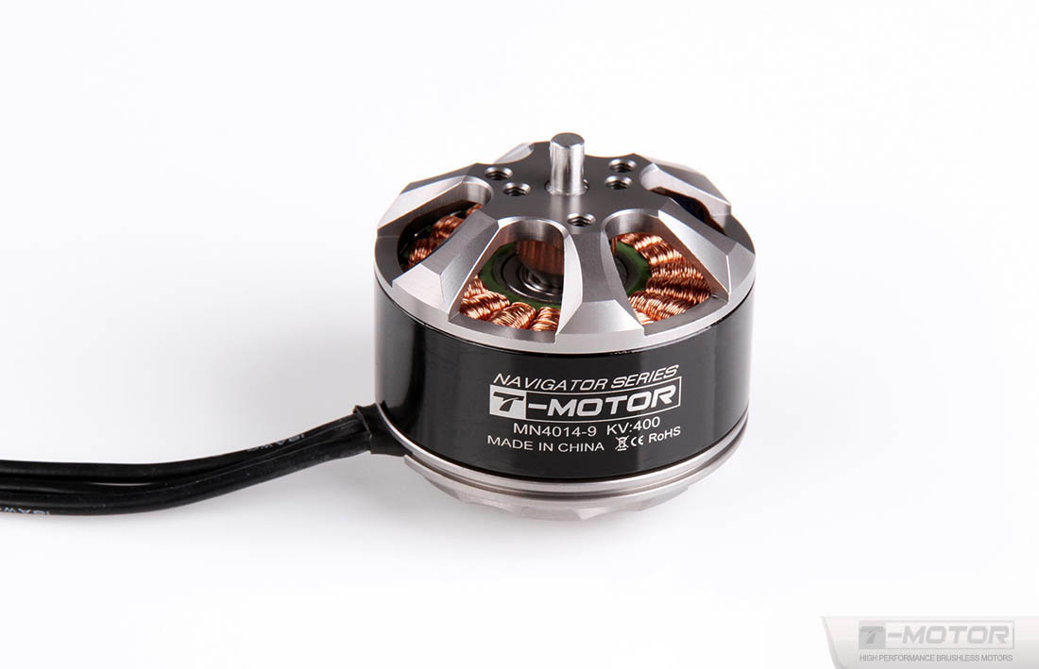
Locomotion System and Actuators
A motor is needed in order to move the propellers
This T-motor is used to spin the blades of the UAV for it to fly in the air
Each propeller is equipped with the same motor so that every propeller can be controlled in the same way

Slide 10
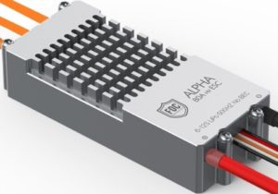
Navigation System and Control
Electronic Speed Control (ESC) are used in UAV in order to control the speed of each motor
By varying the speed of the motor, the UAV can move freely in the air in any direction it desires

Slide 11
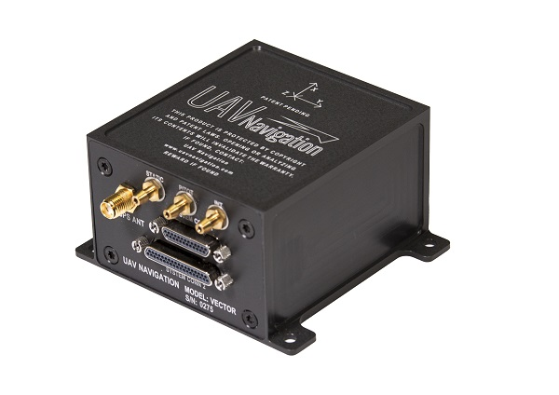
Navigation System and Control
This Vector-600 is an advanced Flight Control Computer (FCC)
Used in UAVs for fully automatic operations
Enclosure material made of aluminium alloy can prevent jamming threat

Slide 12
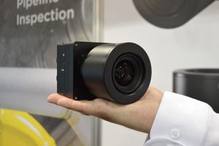
Data Collection
This iXM-series camera can be equipped to a UAV for aerial imaging purposes
Can be used for diverse mapping, surveying and inspection applications
Is made from robust and weatherproof material (IP53 compliant)

Slide 13
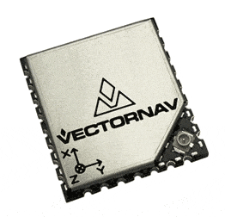
Data Collection
This VectorNav VN-200 is a GPS system used in UAV
It is a satellite-based navigation system that provides geo-spatial positioning data with global coverage
The coordinates of the UAV can be determined using a drone mapping software that can accurately position its output in relation to the real world

Slide 14
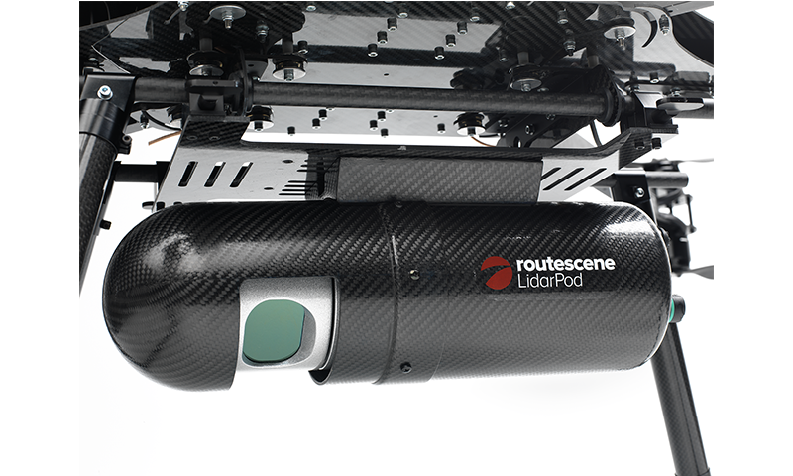
Data Collection
The Routescene LidarPod is a LiDAR sensor used in UAV
It is used to make a 3D mapping of the terrain

Slide 15
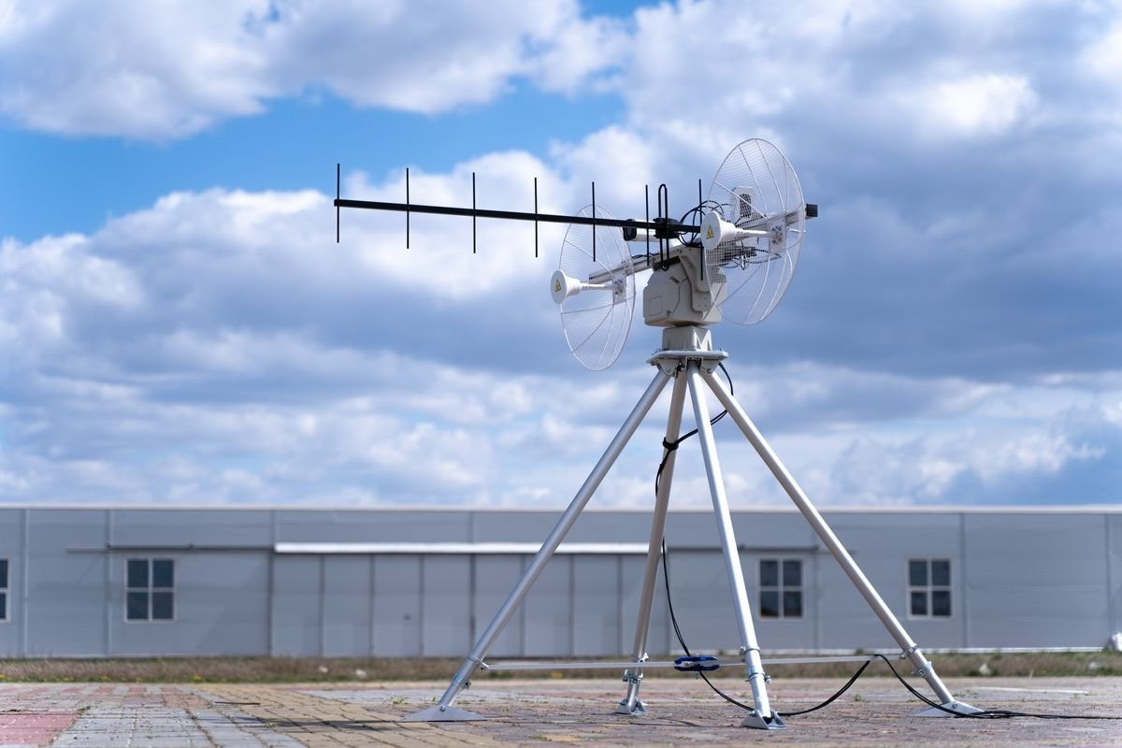
Data Transmission
UAV tracking antennas uses radio communication between the UAV and the ground control station
Provides a reliable HD video transmission

Slide 16
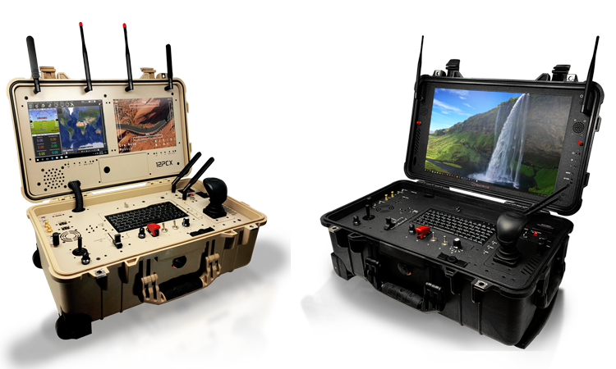
Data Transmission
Ground Control Systems (GCS) are used to control the UAV from the ground
The GCS are equipped with antennas to communicate with the UAV
The GCS have LCD display that can see what the cameras on the UAV sees
The joysticks on the GCS provides manual control over the UAV

Slide 17
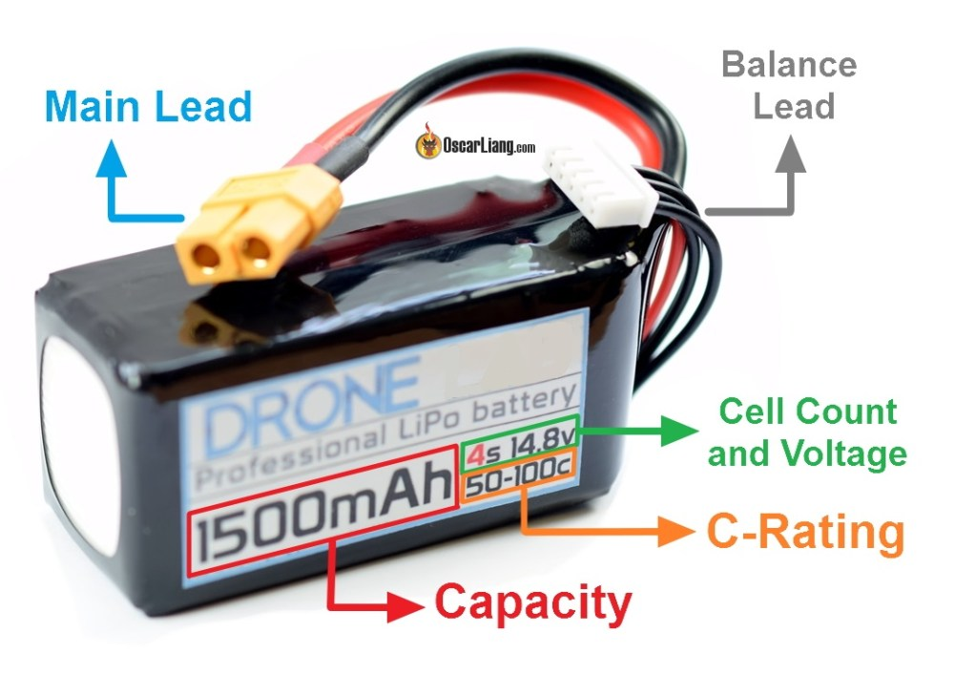
Power Management
UAVs are mostly powered by Lithium-Polymer (LiPo) batteries
LiPo batteries are rechargeable making it suitable for multiple use

